Slide 1
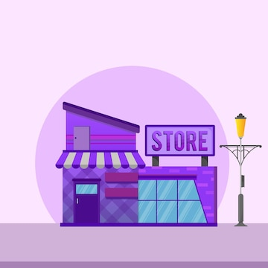
isheji-copy_1735566215318
Urban Store Sales analysis 2024

Slide 2
( ̴
Objective :-
Urban store wants to create an annual sales report for
2024 so that Urban can understand their customer and
grow more sales in 2025

Slide 3
isheji-copy_1735566215318
Sample Question
Compare the sales and orders using single chart?
What are the different order status in 2024?
Who purchased more-men or women in 2024?
Which month got the highest sales and orders?
List top 10 states contributing to the sales?
Relation between age and gender based on numbers?
Which channel is contributing to maximum sales?
Highest selling category?

Slide 4

isheji-copy_1735566215318
Process:-
1.Data cleaning
2.Data processing
3.Data analysis
4.Data visualization
5.Data report
6.Insights and next steps

Slide 5
isheji-copy_1735566215318
Insights
Compare the sales and orders using single chart?
What are the different order status in 2024?
Who purchased more-men or women in 2024
Which month got the highest sales and orders?
List top 10 states contributing to the sales?
Relation between age and gender based on numbers?
Which channel is contributing to maximum sales?
Highest selling category?

Slide 6
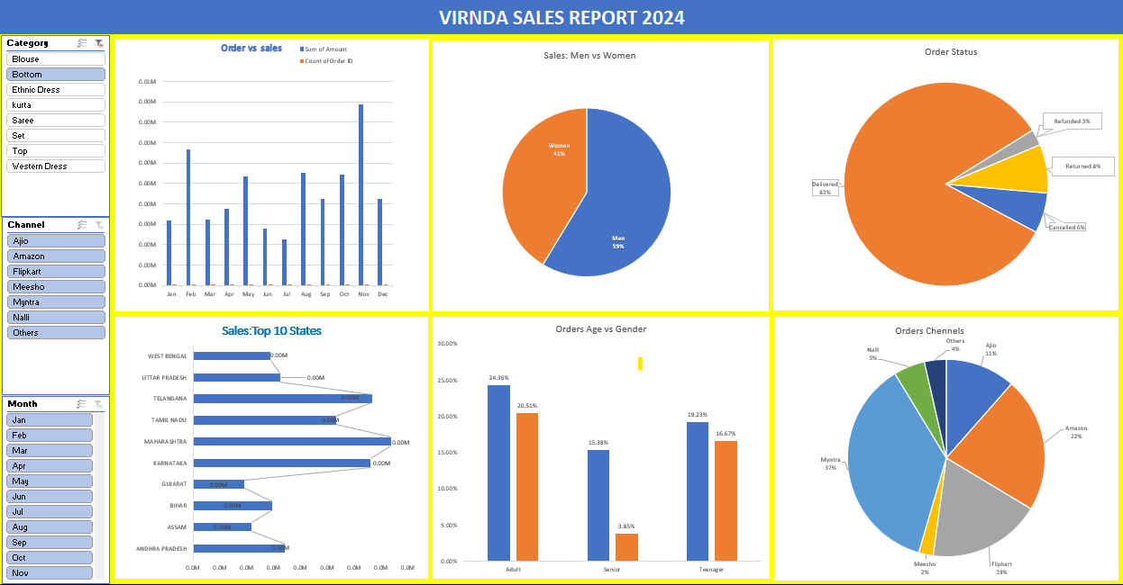
isheji-copy_1735566215318

Slide 7
isheji-copy_1735566215318
Insights
Women are more likely to buy compares to men( ̴65%).
Maharastra, Karnataka and Utter Pradesh are the top 3 states.
Adult age group (30-49) is max contributing ( ̴50%).
Amazon, Flipkart and Myntra channels are max contributing( ̴80%).
Final Conclusion to improve Urban store sales:
Target women customers of age group (30-49 years) living in Maharastra,
Karnataka and Utter Pradesh by showing ads/offers/coupns available on
Amazon, Flipkart and Myntra

